Slide 1
Network Scan Report for Smart Life Limited

Slide 2
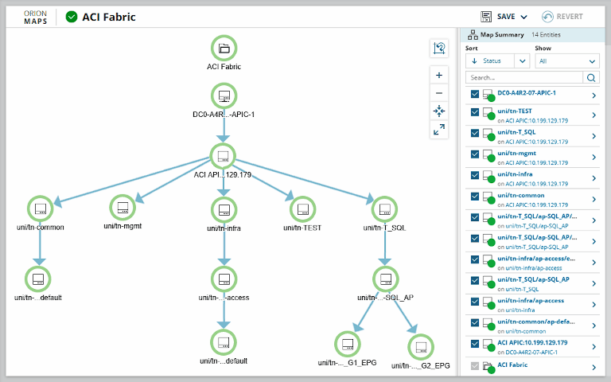

Slide 3
Network Scan Overview
Smart Life Limited's network was scanned using a variety of scanning techniques to assess the security posture of the network.
The scan was conducted from an external perspective to identify any potential vulnerabilities or weaknesses that could be exploited by malicious actors.
This scan was conducted with the proper authorization from Smart Life Limited.

Slide 4
Scanning Software used to conduct the Network Scan
The software used to conduct the network scan was the Auvik scanning system, well known for its ability to spot and detect problems with ease.

Slide 5
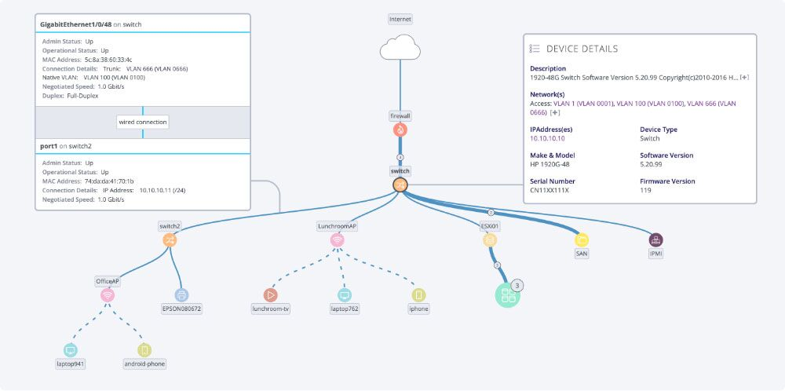
Screenshot of the Network Scan

Slide 6
Scanned IP Addresses and Hosts:
The following IP addresses and hosts were scanned as part of the network scan:
192.168.1.1 (Router)
192.168.1.100 (Server)
192.168.1.101 (Workstation 1)
192.168.1.102 (Workstation 2)
192.168.1.103 (Printer)
192.168.1.104 (IoT device 1)
192.168.1.105 (IoT device 2)

Slide 7
Scanning Techniques Used:
The following scanning techniques were used during the network scan:

Slide 8
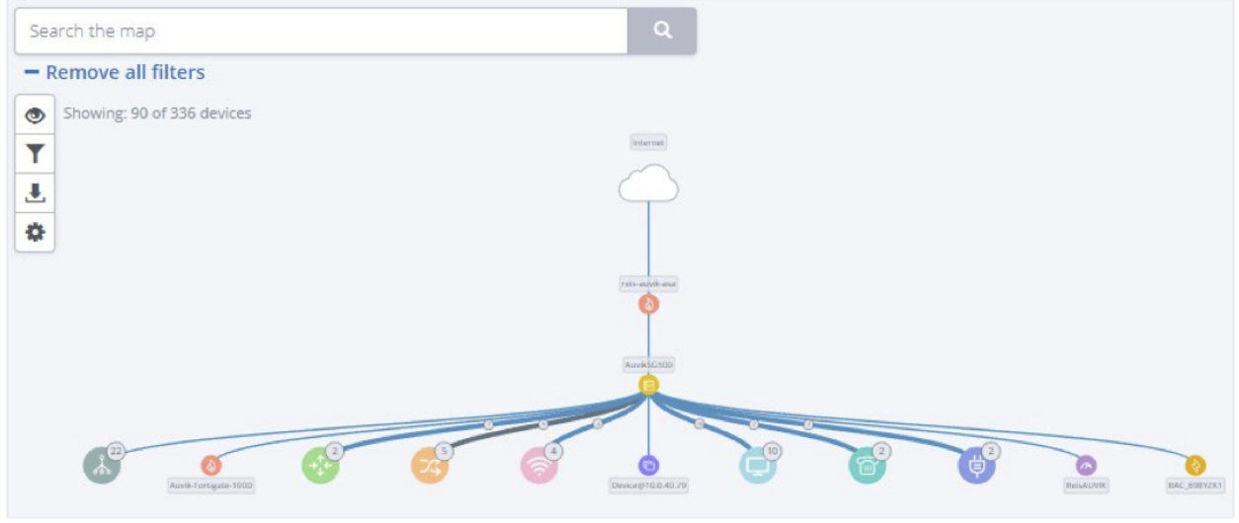
Port Scanning
A TCP and UDP port scan was conducted to identify open ports and services running on each host.

Slide 9
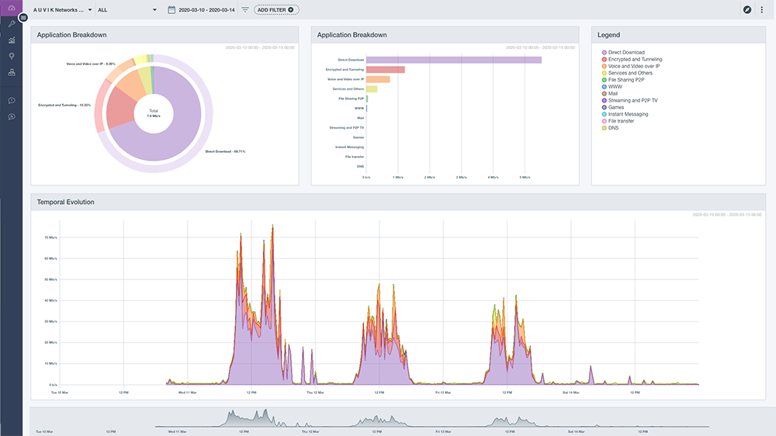
Vulnerability Scanning:
A vulnerability scanner was used to identify known vulnerabilities in the operating systems, applications, and services running on each host.

Slide 10
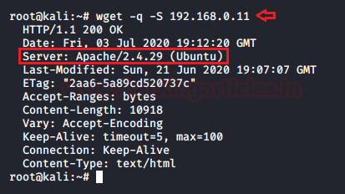
Banner Grabbing
Banner grabbing was performed to gather information about the versions and types of services running on open ports.

Slide 11
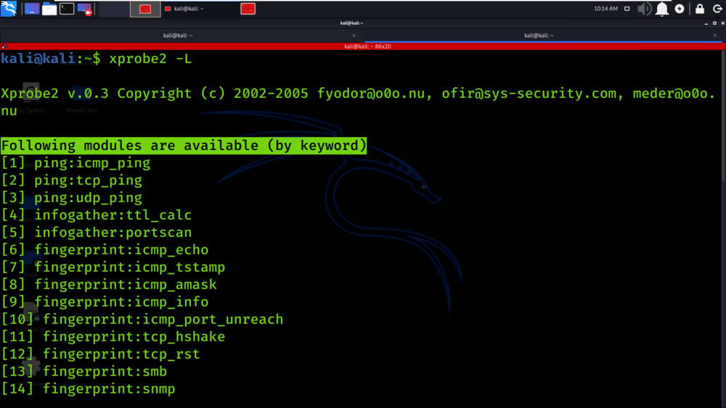
OS Fingerprinting:
OS fingerprinting was used to determine the operating systems running on each host.

Slide 12
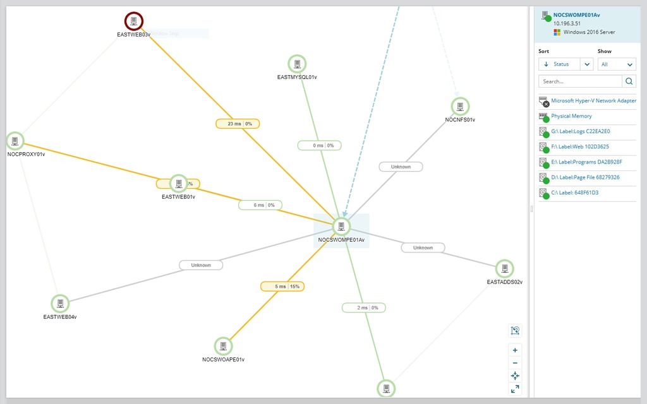
Network Mapping
Network mapping techniques were used to create a map of the network topology, including identifying routers, switches, and other network devices.

Slide 13
Findings:
The network scan revealed the following findings:

Slide 14
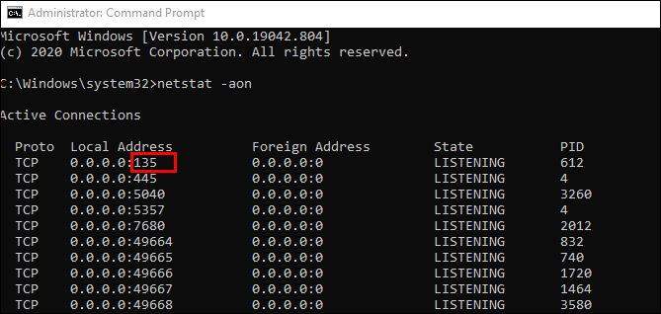
Open Ports:
Several hosts had open ports that were accessible from the external network, including port 22 (SSH), port 80 (HTTP), and port 443 (HTTPS).

Slide 15
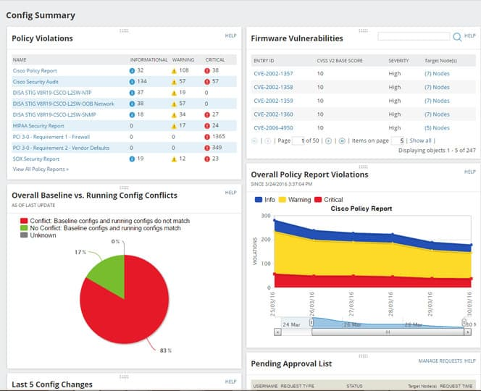
Vulnerabilities:
The vulnerability scan identified several known vulnerabilities in the operating systems, applications, and services running on the scanned hosts. These vulnerabilities included outdated software versions, missing patches, and default credentials.

Slide 16
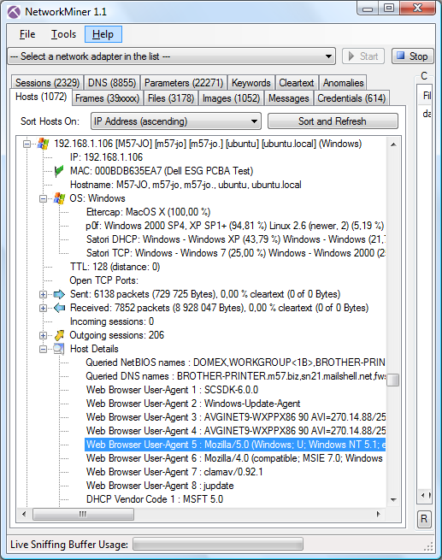
OS Fingerprinting:
The OS fingerprinting results indicated that most of the hosts were running Linux-based operating systems, including Ubuntu, CentOS, and Debian.

Slide 17
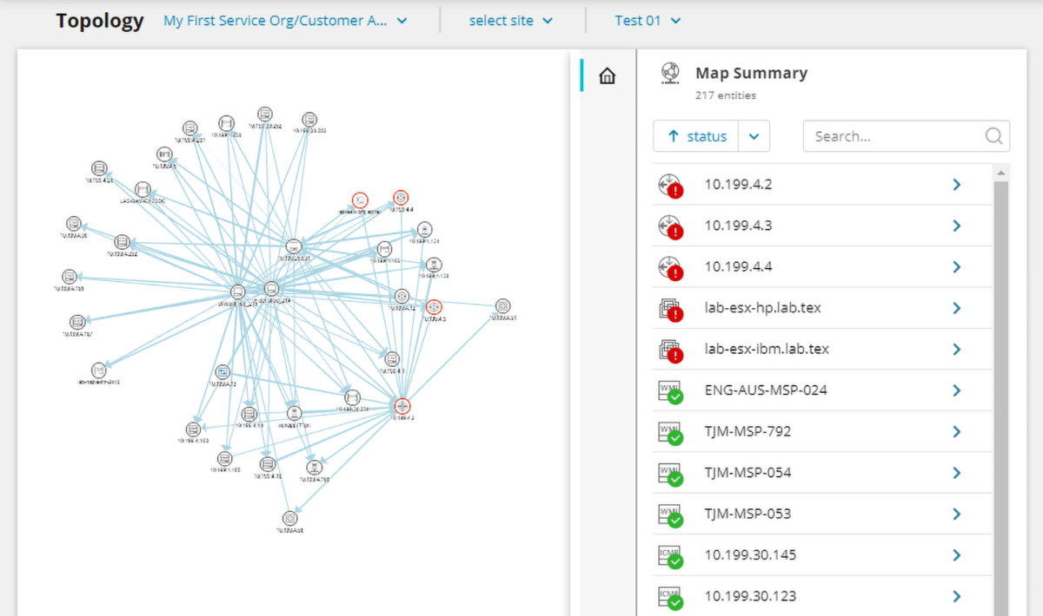
Network Mapping
The network mapping revealed the network topology of Smart Life Limited, including the router, server, workstations, printer, and IoT devices. The mapping also identified some network devices that were not properly secured, such as switches with default configurations.

Slide 18
Recommendations:
Based on the findings of the network scan, the following recommendations are provided to enhance the security of Smart Life Limited's network:

Slide 19
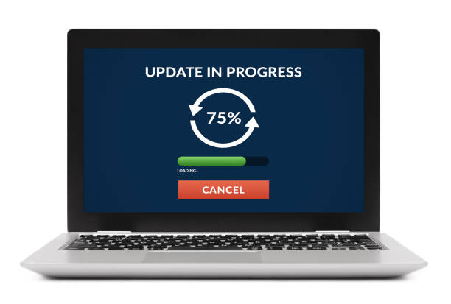
Recommendations (ctd):
Keep all software and operating systems up-to-date with the latest patches and security updates to address known vulnerabilities.

Slide 20
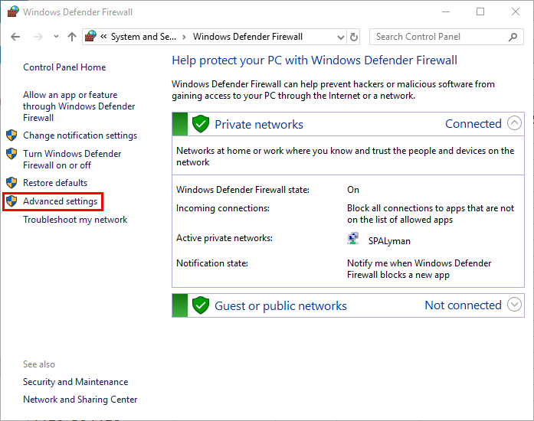
Recommendations (ctd):
Close unnecessary open ports and services that are not required for business operations.

Slide 21

Recommendations (ctd):
Implement proper authentication and access controls, including strong and unique passwords, on all network devices, servers, workstations, printers, and IoT devices.

Slide 22
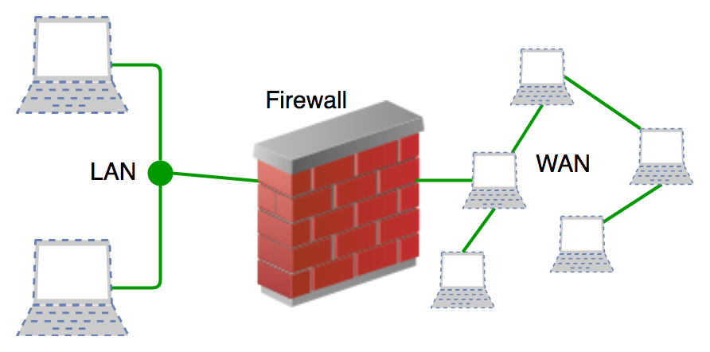
Recommendations (ctd):
Regularly review and update firewall rules to restrict inbound and outbound traffic to only necessary ports and services.

Slide 23
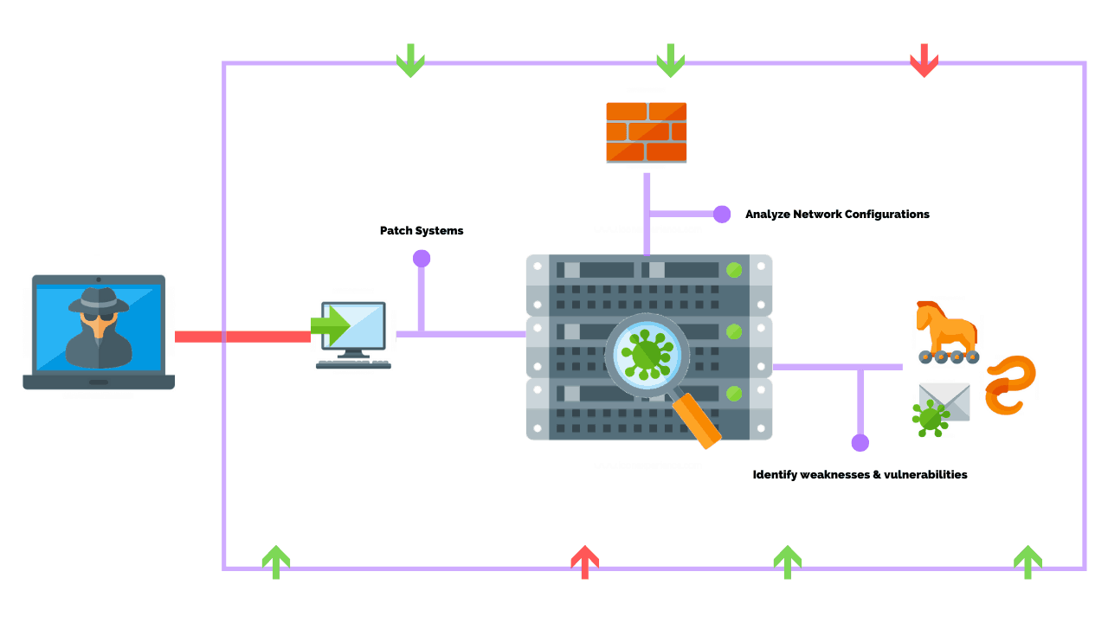
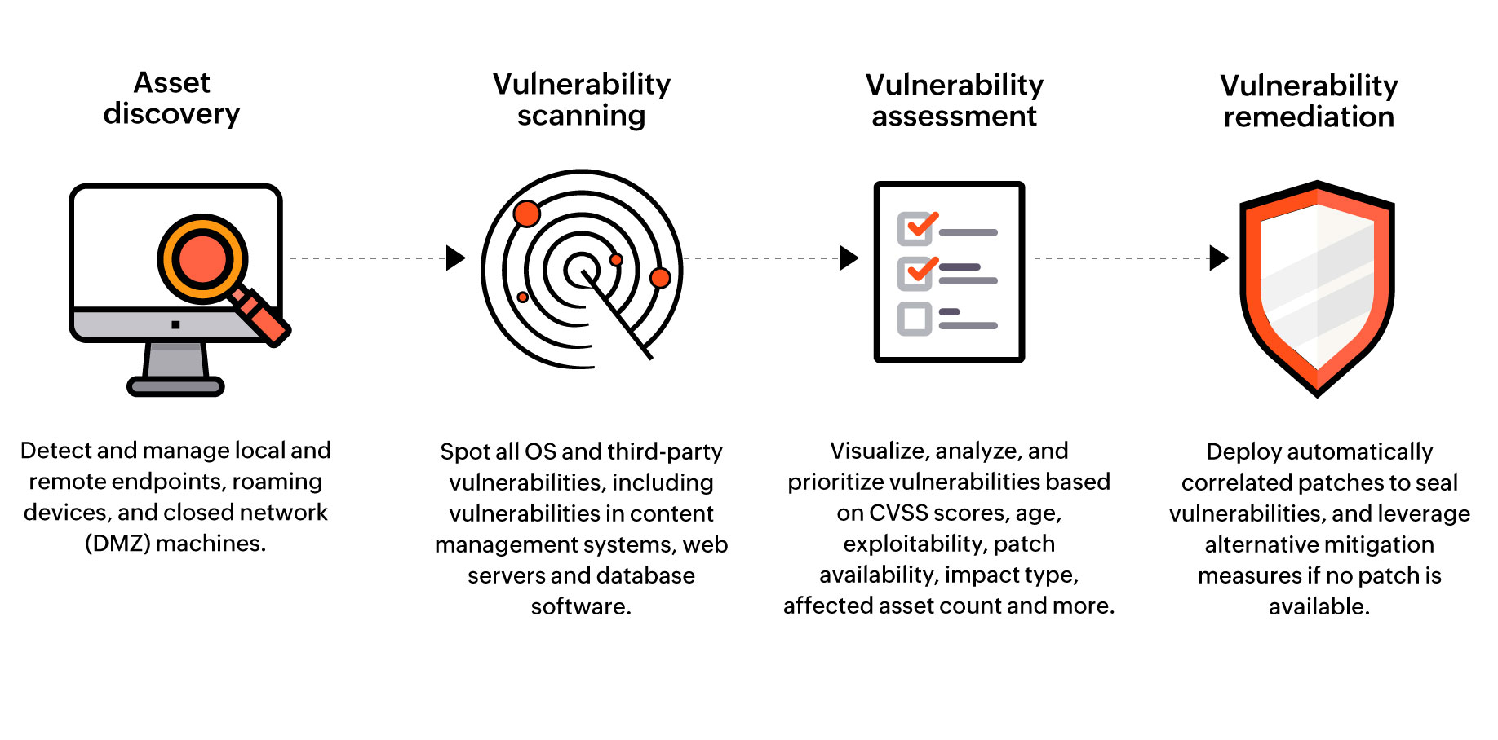
Recommendations (ctd):
Conduct regular vulnerability assessments and penetration tests to proactively identify and address potential vulnerabilities and weaknesses in the network.

Slide 24
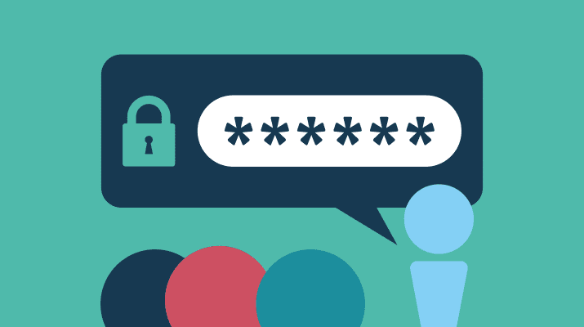
Recommendations (ctd):
Disable default or weak credentials on network devices, and enforce strong password policies for all users.

Slide 25

Recommendations (ctd):
Train employees to be cyber-street-smart, which means avoiding clicking on suspicious links or downloading attachments from unknown sources.

Slide 26

Conclusion:
The network scan provided insights into the security posture of Smart Life Limited's network, revealing potential vulnerabilities and weaknesses that could be exploited by malicious actors.

Slide 27
Conclusion (ctd)
By implementing the recommended measures, Smart Life Limited can enhance the security of its network and protect against potential cybersecurity threats.
It can take steps to patch known vulnerabilities, configure proper authentication and access controls, regularly review and update firewall rules, conduct regular vulnerability assessments, and train employees on cybersecurity best practices.

Slide 28
Conclusion (ctd)
It's important for Smart Life Limited to prioritize network security to safeguard its sensitive data, protect its systems and devices, and mitigate potential risks associated with cyber threats. It is also recommended to perform regular network scans and security assessments to continuously monitor and improve the security posture of the network.

